Slide 1
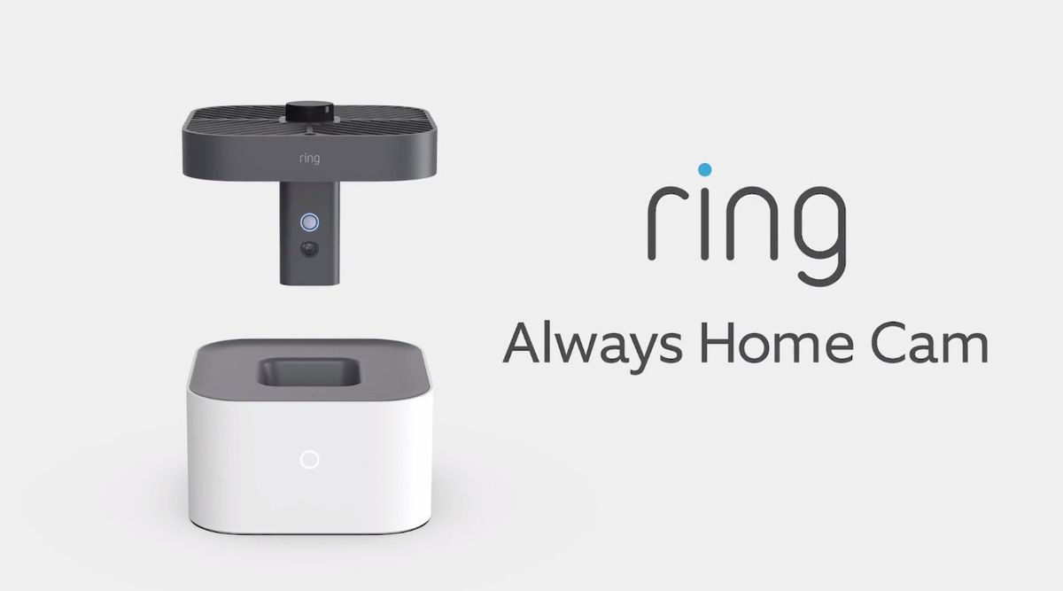
ETM 555 - Technology Marketing
Marketing Plan - Always Home Camera
Team 1 - Members
Alan Vijay, Prenidha
Hammigi Bhaktavatsala, Pruthvi
Patil, Neelima
Prem Kumar, Annie Catherine
Rajkarne, Piyush Vilas
Sonawane, Aditi Vijay
Notes:
Annie

Slide 2
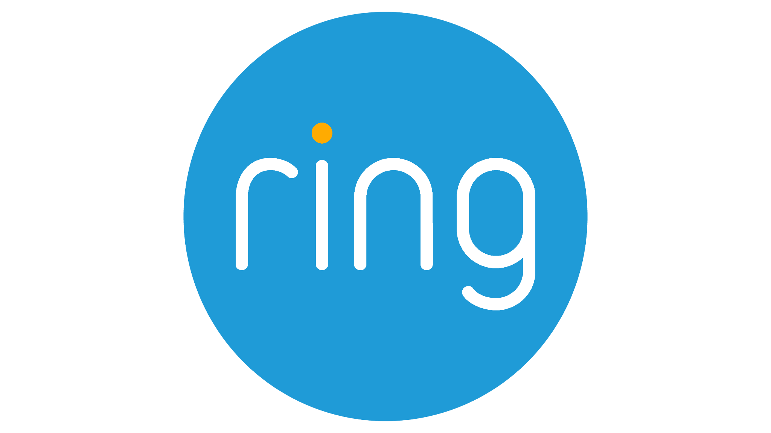
What is the problem? What is our Product?
Notes:
Annie

Slide 3
Market Size
TAM
The global smart home security camera market is projected to reach $30.1 billion by 2030.
SAM
The segment of the market is estimated at approximately $11.96 billion by 2030.
The obtainable market, with approximately $2.39 billion by 2030
SOM
Notes:
Aditi
TAM - https://www.marketsandmarkets.com/Market-Reports/home-security-system-market-205573901.html?utm_source=chatgpt.com
SAM - https://www.sphericalinsights.com/reports/north-america-home-security-systems-market?utm_source=chatgpt.com
SOM - https://www.grandviewresearch.com/industry-analysis/smart-home-security-camera-market
First, let's talk about TAM—Total Addressable Market. This represents the entire global demand for home security solutions, without considering competition or business constraints. According to market research, the global home security market was valued at $52.3 billion in 2021 and is projected to reach $84.4 billion by 2027.
Next, we refine our focus to SAM—the Serviceable Available Market. This is the portion of TAM, and it is based on our target market and product scope. Since we're focusing on North America, where the home security market is projected to grow to $49.67 billion by 2032, this becomes our SAM.
Finally, we define SOM—the Serviceable Obtainable Market. This is the actual market share we can capture, factoring in competition and resources. In the U.S., Ring holds 28% of the home security market, showing the dominance of key players. If 'Always Safe Home' aims to capture even a 5% share of the North American market, that would represent a revenue opportunity of approximately $2.5 billion by 2032.
TAM 1.84B
SAM 217M
SOM 2.19M

Slide 4
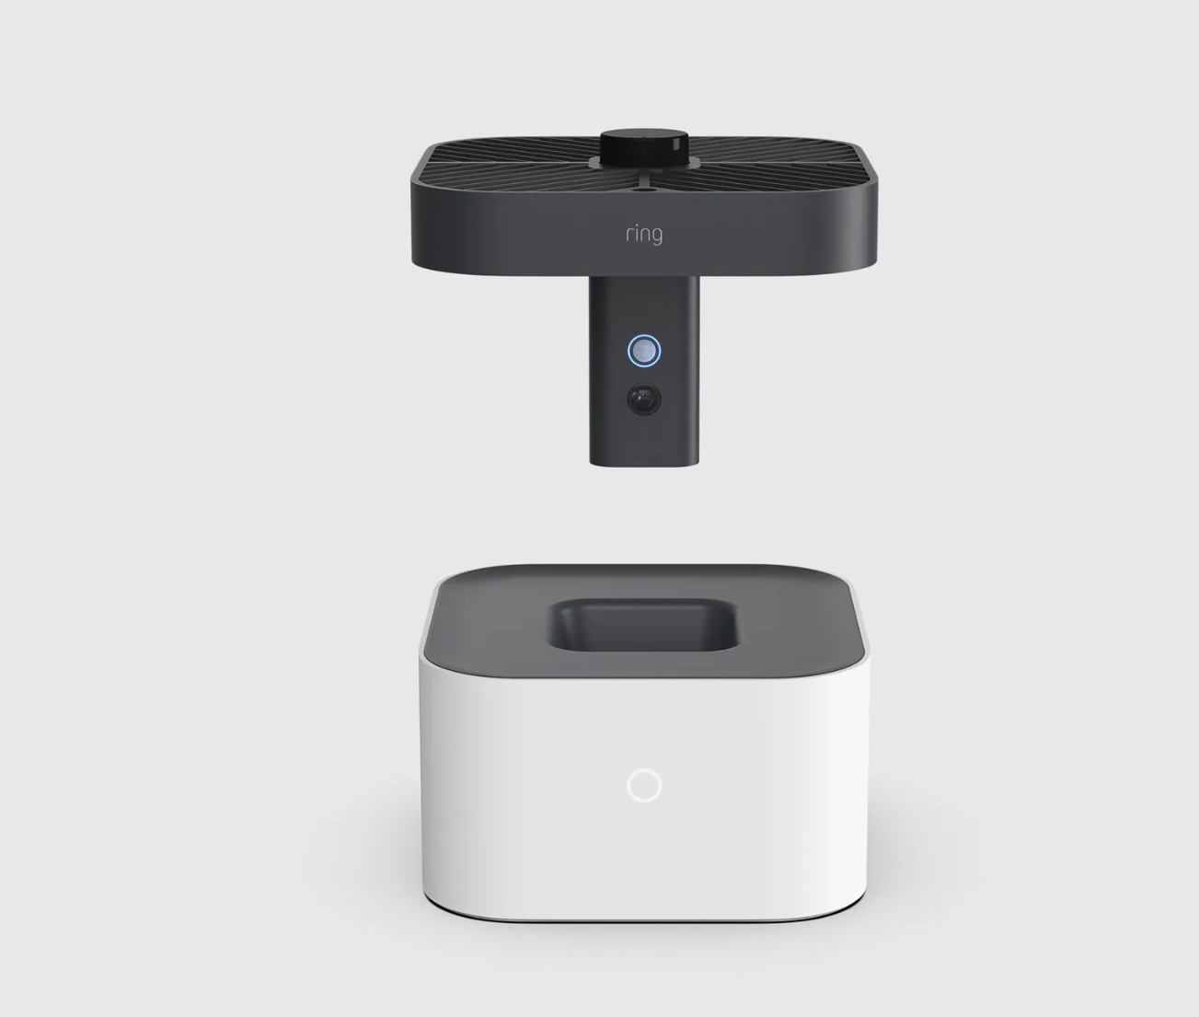
Market Trends
Rising Demand for Home Security
Crime Statistics & Security Gaps
Flexibility & Mobility of Wireless Security
Smart Home Integration
Alexa, Nest
Rising crime rates and property damage
Growth of Wireless Security Cameras
Advancements in Night Vision & Faster Connectivity
Infrared (IR) technology, Fixed Wireless Access(FWA)
Notes:
Prenidha

Slide 5
Target Market Segments
Home Owners
Families with Children, Pets, Senior Citizens
Real Estate Owners
Insurance Companies
Real-time video evidence of theft incidents or property damage,
Claims processing
Surveillance for lobbies, hallways, or parking lots
Frequent Travelers
Government & Defense
Monitoring embassies, courthouses, parliament buildings, military bases
Remote monitoring of homes during vacations, work trips
Small Business Owners
After hours monitoring, Eliminates hiring of Security Guard
Notes:
Prenidha

Slide 6
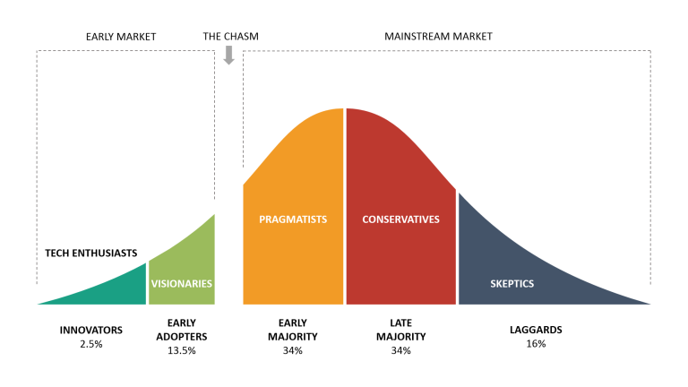
Technology Adoption Lifecycle
S Curve Adoption
How to cross the chasm?
Target the Right Niche
Address Pain Points & Reduce Perceived Risk
Leverage Influencers
Love innovation Tech bloggers Product reviewers
High tech protection Trendsetters Early smart home adopters
Busy Professionals Prioritize safety
Influenced by friends Low cost security
Rely on traditional methods Older population
Pricing & Promotion Strategy
Notes:
Pruthvi

Slide 7
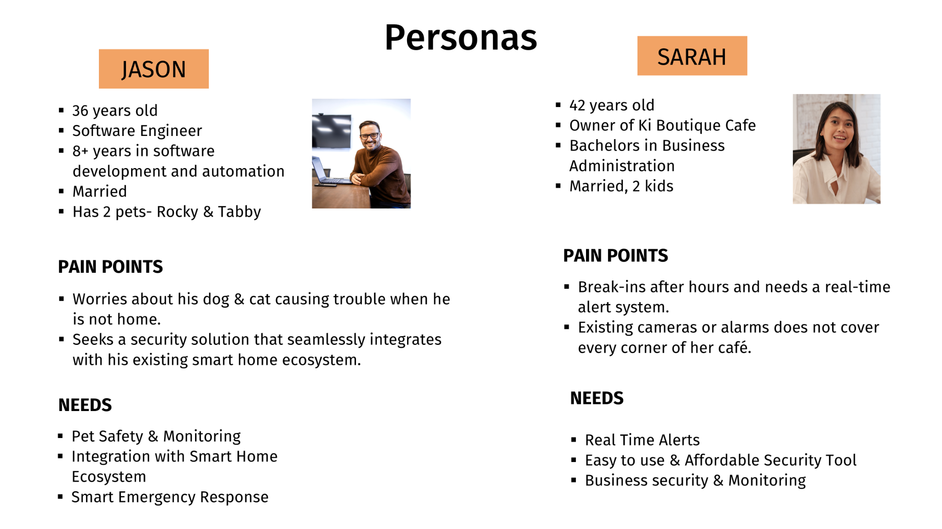
Notes:
Neelima

Slide 8
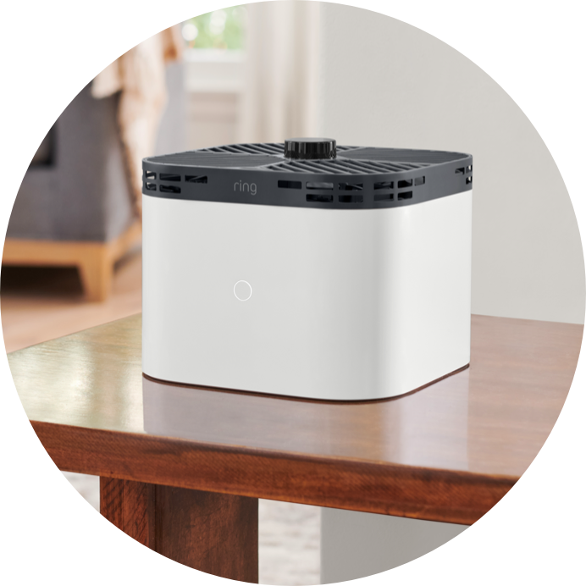
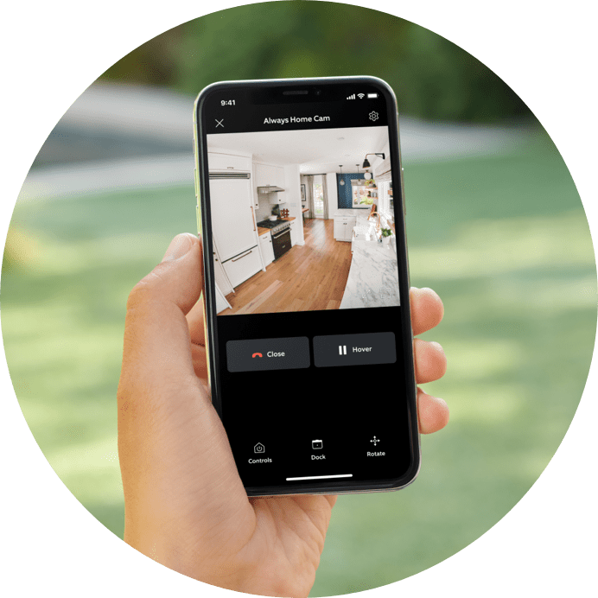
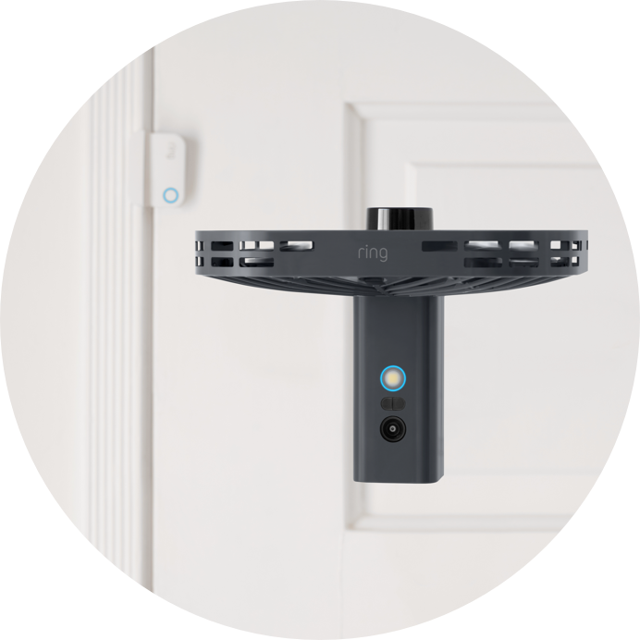
Value Proposition
PRODUCT
CUSTOMER
BENEFITS
WANTS
Enhanced Security,
Real Time Monitoring,
Alternate for network of cameras, Asset Protection,
Evidence for Insurance
Real time security updates, Smart home ecosystem,
Monitoring children, pets, and elderly family members
FEATURES
FEARS
Privacy, false alerts, reliability
360 degree coverage,
Smart navigation, Automatic Response to Triggers, Seamless Integration with other Ring devices
NEEDS
EXPERIENCE
Peace of mind
Effortless control, Advanced Technology, Value for money.
One Camera. Every angle. Total peace of Mind.
Notes:
Neelima

Slide 9
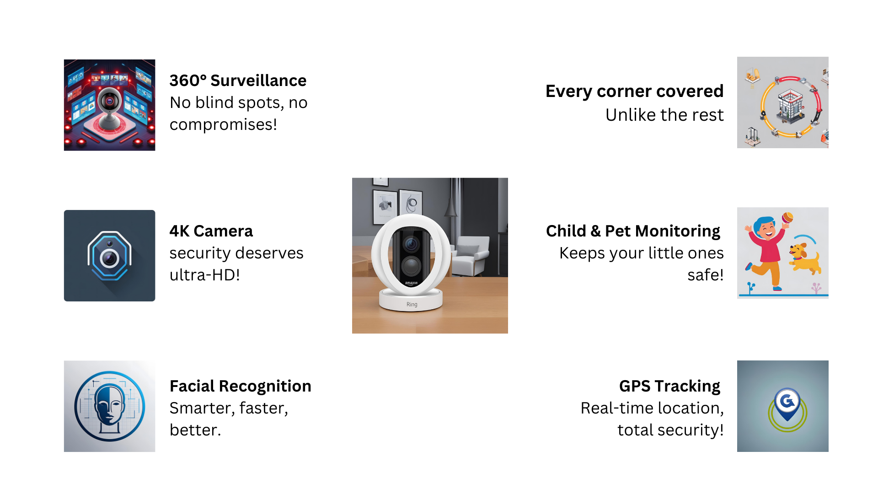
Competitive Analysis
🔹 Competitors: SimpliSafe, ADT, Deep Sentinel, Vivint, Frontpoint, Scout Alarm, Abode
❌ Competitors miss these crucial features But We don’t :)
Notes:
Piyush

Slide 10
4Ps of Marketing
Product
Place
Autonomous Indoor Flying Security Camera
Retail stores, online and Direct to Consumer(website)
Promotion
Price
Introductory Offers, Seasonal Discounts, Partnerships with Home Insurance Companies
Premium Pricing Strategy ($249 - $399
Estimated Price Point) Cost of Advanced Technology & R&D Recovery
Notes:
Pruthvi

Slide 11

Pricing Strategy - Value-Based Pricing
Category | Low-End Estimate | High-End Estimate
Manufacturing Cost | $144 | $194
Marketing & Advertising | $40 | $75
Support & R&D | $25 | $40
Profit Margin | $40 | $90
Retail Price | $249 | $399
Notes:
Aditi
The $249 - $299 price point for the Ring Always Home Cam aligns more with Value-Based Pricing rather than Competitive Pricing, though elements of both strategies are present.
Why is it Value-Based Pricing?
✅ Pricing Justifies Unique Value → The Ring Always Home Cam is an autonomous security drone, a first-of-its-kind consumer product. The price is set based on the value it provides (AI-powered home surveillance, automated patrolling, and real-time alerts).
✅ Solves a Pain Point → Instead of installing multiple security cameras, this single device provides whole-home coverage, making it a cost-effective alternative despite its higher price.
✅ Willingness to Pay → Customers who invest in home security products (like Ring users) value peace of mind, which justifies a premium price.
Why It’s NOT Purely Competitive Pricing
🔹 Lack of Direct Competitors → No other major brand offers an autonomous security drone. Unlike regular security cameras, it has unique features that set it apart.
🔹 Higher Perceived Value → Unlike standard security cameras priced at $100 - $200, this product justifies its higher price through advanced AI, mobility, and automation.
But There’s Some Competitive Pricing Too...
🔹 The Nest Cam IQ (a premium smart security camera) was priced at $399 before discontinuation. Ring strategically priced lower ($249 - $299) to stay more affordable than ultra-premium competitors.
🔹 Standard Ring cameras range from $100 - $200, so this device is positioned as a premium but accessible option, keeping it within Ring’s ecosystem.
Final Verdict: Primarily Value-Based Pricing
🔹 The price is not set based on competition alone but rather on the unique value the product delivers.
🔹 It’s still positioned competitively against premium security solutions, making it accessible while maintaining strong margins.

Slide 12
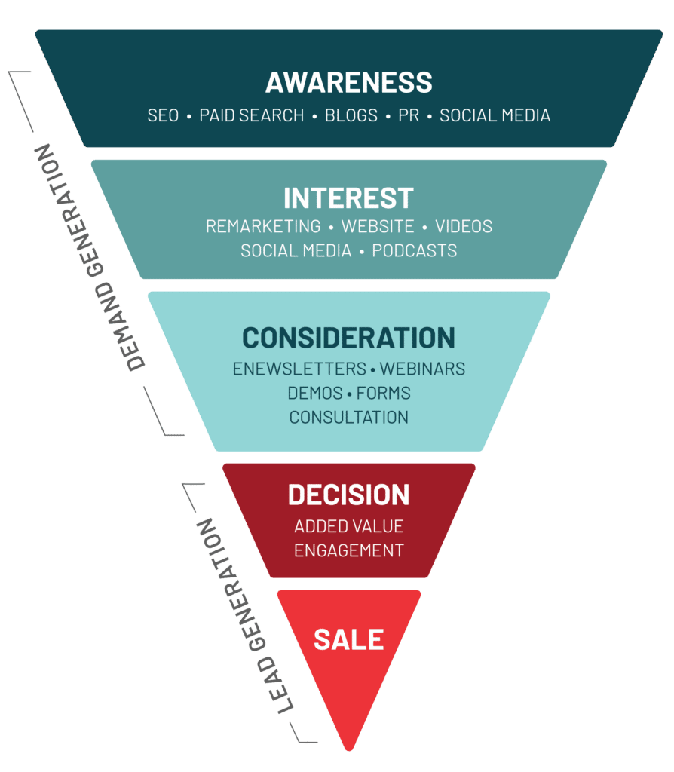
Demand Generation Funnel
}
Content Marketing
Social Media Campaigns
“Home security that flies to you! Discover the future of smart home protection.”
}
Email Campaign
Free Consultations
Worried about home security? Let the Always Home Cam do the patrolling for you!
}
Onboarding Emails
Limited-Time Discounts & Bundles
Limited-time offer: Free shipping + 10% off when you order today!
Notes:
Annie
Objective: Attract potential customers and generate interest.
Content Marketing: Blog posts on "Smart Home Security Trends," "How Drones are Changing Home Security," and "Best Home Security Gadgets."
Social Media Campaigns: Instagram/Facebook ads showcasing how the cam autonomously patrols the home.
Influencer Partnerships: Tech YouTubers and home security bloggers reviewing the product.
Paid Ads & SEO: Google Ads targeting keywords like "best home security cameras" and "smart home drone camera."
"To generate demand for the Ring Always Home Cam, we are leveraging a multi-channel approach that builds awareness, engages potential customers, and drives conversions."
1️⃣ Content Marketing:
"We are creating high-quality blog posts, video content, and product comparisons to educate consumers about the benefits of autonomous home security. This includes SEO-optimized articles like 'How Smart Home Drones Are Changing Security' and video demonstrations highlighting real-world use cases."
2️⃣ Social Media Marketing:
"We are running targeted ad campaigns across Instagram, Facebook, and YouTube, using engaging videos and influencer collaborations. Our campaigns include interactive polls, user-generated content, and teaser clips showcasing the Always Home Cam in action."
3️⃣ Free Trials at Retail Stores:
"To build trust and firsthand experience, we are offering in-store demos and free trial opportunities at major retail locations like Best Buy and Amazon pop-ups, allowing customers to see the technology in action."
4️⃣ Limited-Time Offers & Promotions:
"To drive urgency, we are introducing time-sensitive promotions such as 'Buy now and get 20% off your first Ring Protect subscription!' and exclusive early-bird discounts for pre-orders."
5️⃣ Engaging Taglines & Calls-to-Action:
"We’re capturing attention with powerful taglines like 'Home security that flies to you!' and 'The future of home surveillance is here!'—designed to create curiosity and drive engagement across channels."
"By integrating these strategies, we ensure that we not only capture attention but also convert that interest into long-term customers and brand advocates.

Slide 13




Demand Generation - Taglines
Home Owners
Pet Owners
TV ads, Google search, in-store displays
TikTok, Instagram, pet influencers
"Know what your pet is up to, in real-time."
"The future of home security is here."
Tech Enthusiasts
Frequent Travelers
Tech blogs, YouTube, social media, online ads
Email marketing, travel blogs, influencer marketing
"See every corner of your home—only when you need to."
"Stay connected to home, wherever you go."
Notes:
Annie

Slide 14
Brand Strategy
Mission, Brand Messages
Mission: Smart Autonomous Security
Tagline: Always Home, Always Secure
Marketing & Partnerships
Multi Channel Marketing, Co Branding
Community Engagement
Ring Neighbors App, Neighborhood Campaigns, Watch Program
Notes:
Prenidha

Slide 15






Marketing Communications
Marketing Communications
Traditional
Digital
Influencer
PR Content
Retail
Community Engagement
Press Release, Sponsorships
Partnerships
TV & Radio ads, Billboards, Magazines
Facebook, Instagram,
YouTube
Blogs,
Podcasts,
Vlogs
Amazon,Best Buy,Home Depot
Word of mouth, “Neighbors” app
Notes:
Prenidha

Slide 16
Partnerships & Co Branding
1
3
5
Smart Home Integration
Ring Alarm Security System, Samsung SmartThings
Lifestyle & Consumer
Pet Brands
Airbnb
Retail & ECommerce
Best Buy, Home Depot, Lowe’s, IKEA
2
4
6
Home Insurance Companies
State Farm, Allstate, Geico, ADT, SimpliSafe
Content & Brand Awareness
Netflix, Hulu, YouTube Originals
Cybersecurity packages
Co brand with Ring Protect Plan, Apple - HomeKit
Notes:
Prenidha

Slide 17
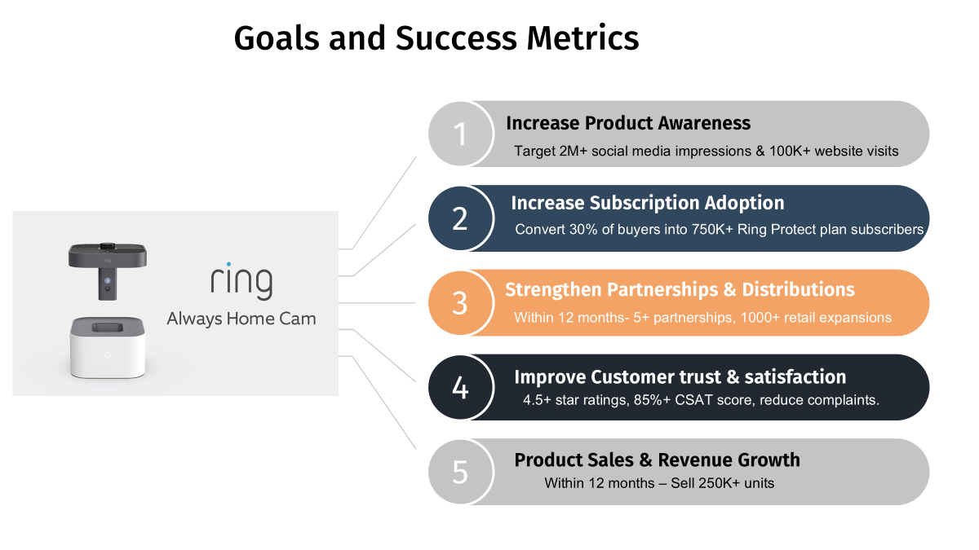
Notes:
Neelima

Slide 18

Questions?

Slide 19
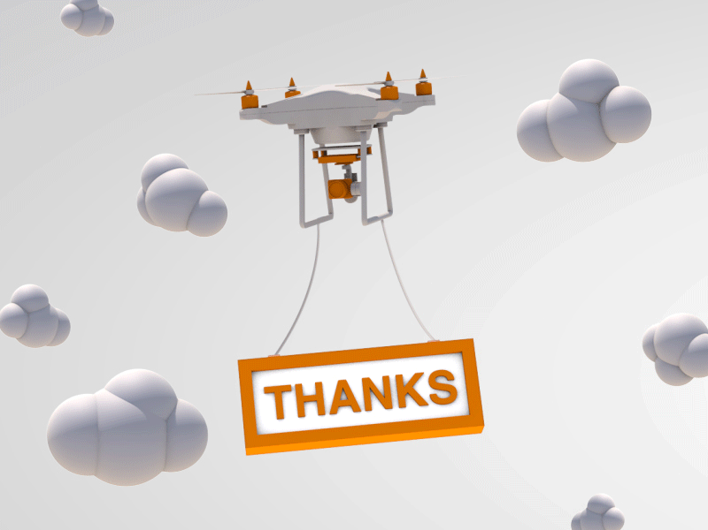

Slide 20
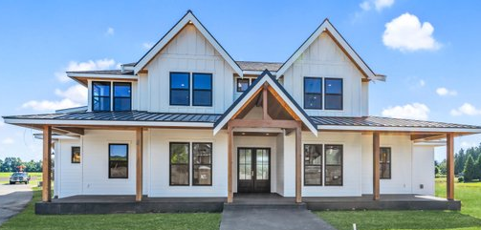
Amazon - Ring
History
Founded: 2012 (originally as "Doorbot")
Founder: Jamie Siminoff
Acquired by: Amazon in 2018 for over $1 billion
Industry: Smart Home Security and Internet of Things (IoT)
Headquarters: Santa Monica, California, USA
Parent Company: Amazon
Mission & Vision
Making neighborhoods safer with affordable, smart security solutions for a connected and protected future.
Notes:
Annie

Slide 21
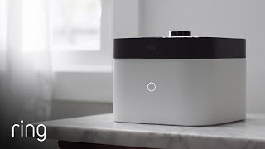
What is the problem? What is our Product?
Notes:
Annie

Slide 22
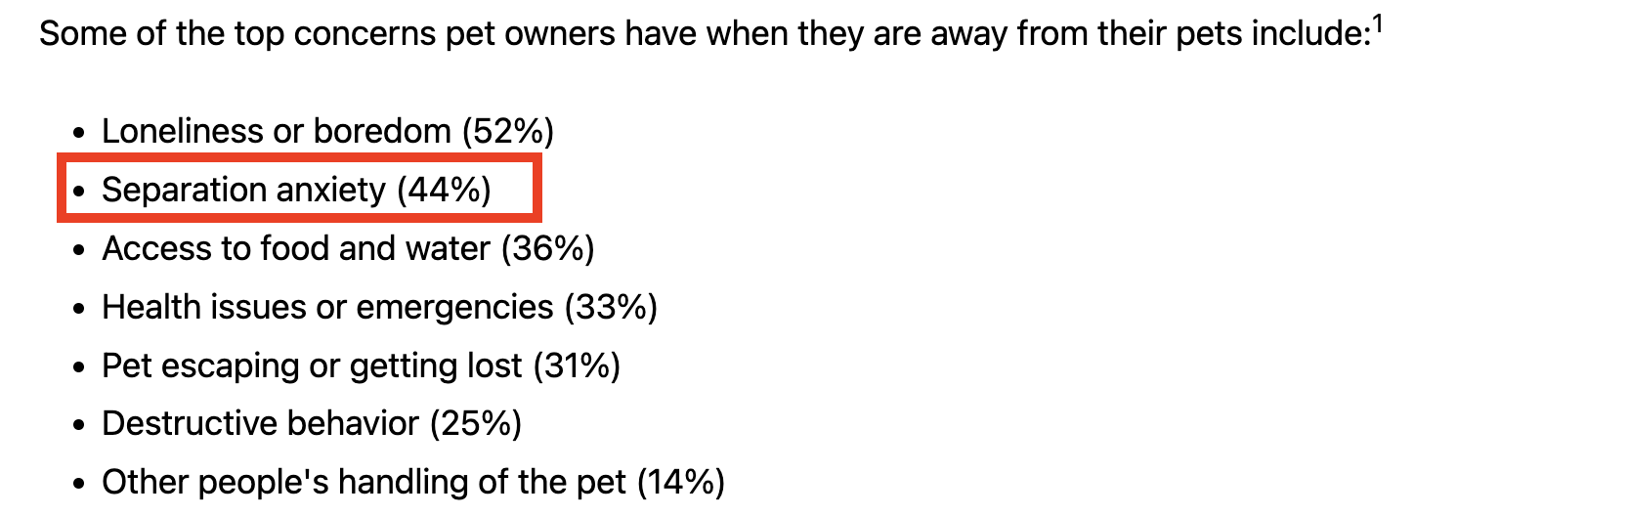
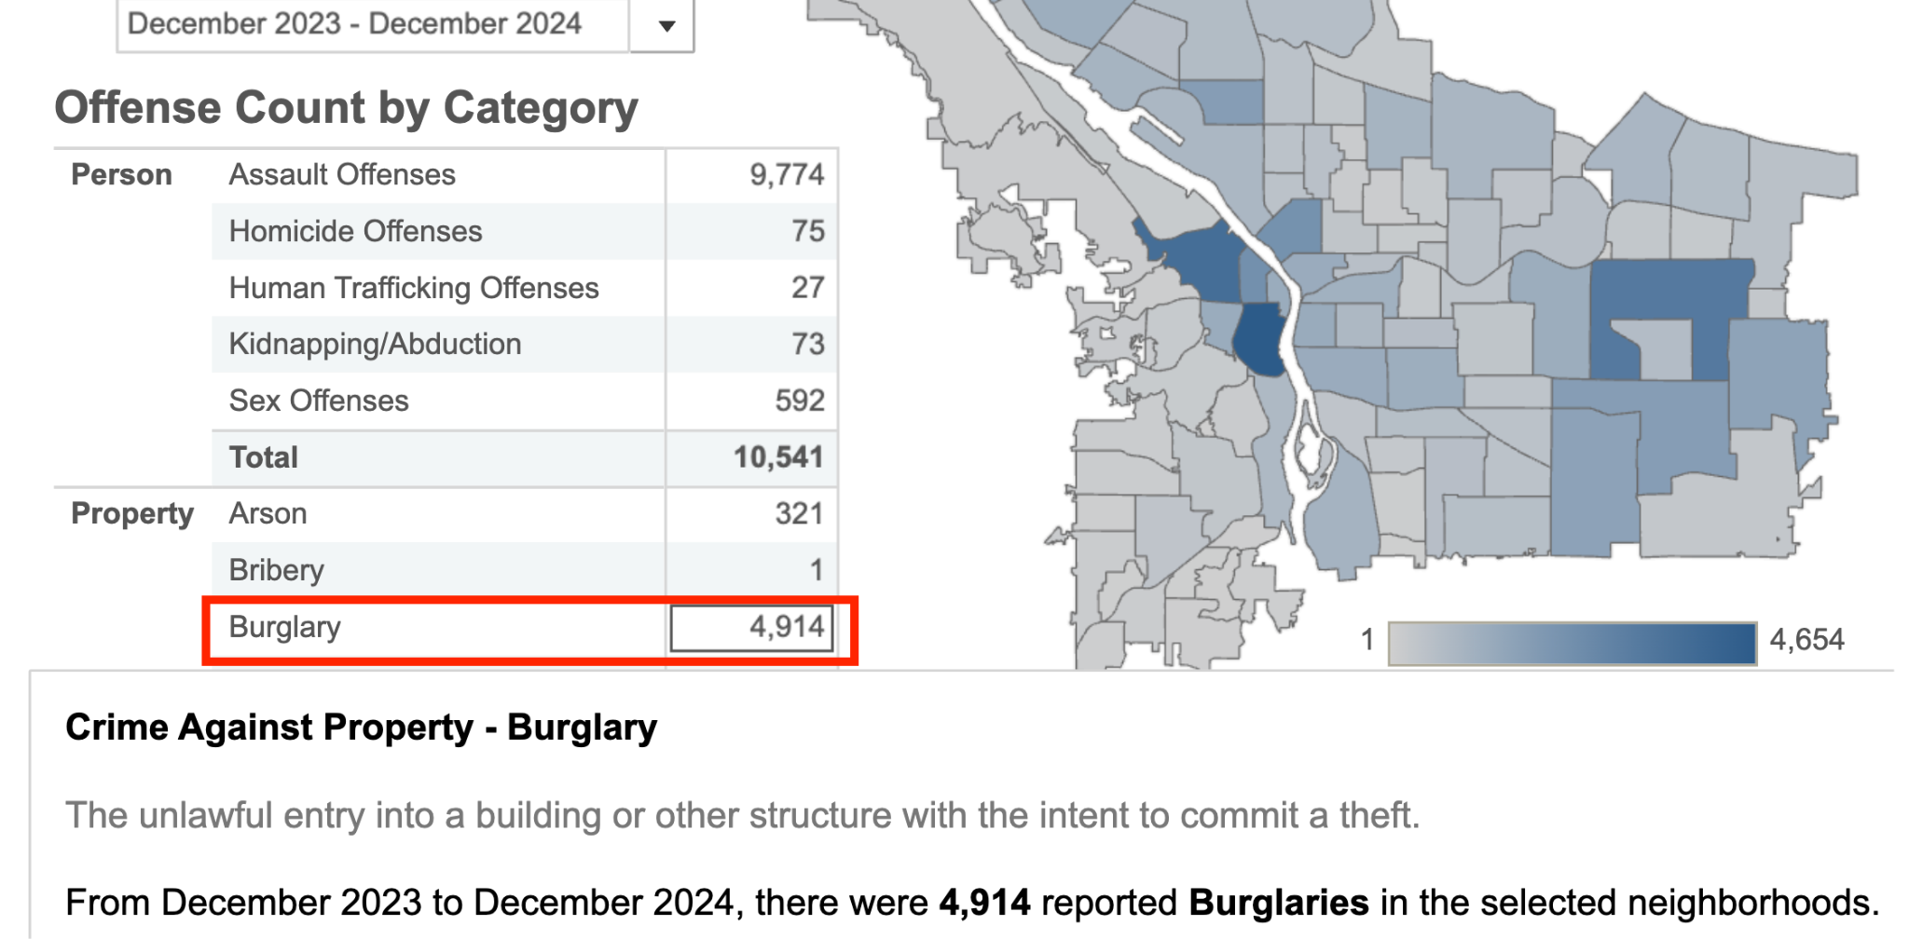
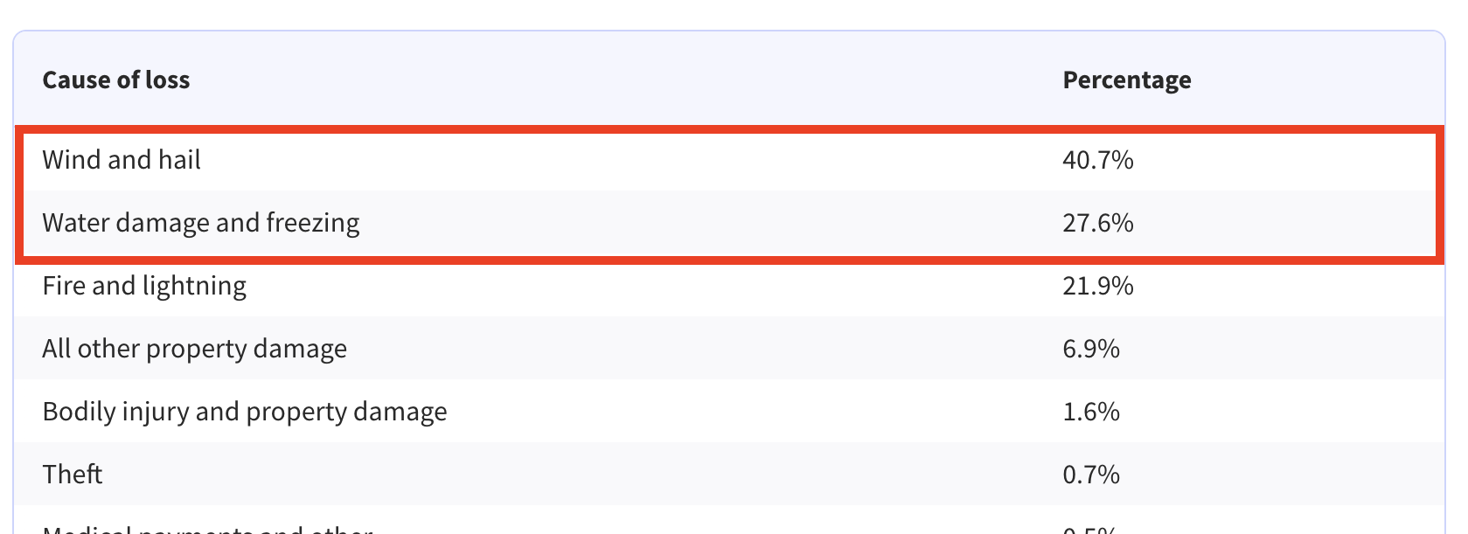
What is the problem?
Burglaries and Home Invasions
Pet Monitoring
Asset
Protection
Notes:
Annie

Slide 23
Always Home Camera
360° Autonomous Surveillance
Obstacle Avoidance
Real-Time Monitoring with App Integration
Advanced Privacy Controls
Smart Motion Detection
Tamper Detection and Anti-Theft Mode
Notes:
Annie

Slide 24
Global Home Security Systems Market: Valued at $52.3 billion in 2021, projected to reach $84.4 billion by 2027
TAM
North America Home Security Systems Market is projected to reach $49.67 billion by 2032
SAM
SOM
Ring Market Share 28% in the U.S
Growth Projection: Grow 20.7% from 2025 to 2030 reaching ~$30 billion by 2030
Notes:
Aditi
TAM - https://www.marketsandmarkets.com/Market-Reports/home-security-system-market-205573901.html?utm_source=chatgpt.com
SAM - https://www.sphericalinsights.com/reports/north-america-home-security-systems-market?utm_source=chatgpt.com
SOM - https://www.grandviewresearch.com/industry-analysis/smart-home-security-camera-market
First, let's talk about TAM—Total Addressable Market. This represents the entire global demand for home security solutions, without considering competition or business constraints. According to market research, the global home security market was valued at $52.3 billion in 2021 and is projected to reach $84.4 billion by 2027.
Next, we refine our focus to SAM—the Serviceable Available Market. This is the portion of TAM, and it is based on our target market and product scope. Since we're focusing on North America, where the home security market is projected to grow to $49.67 billion by 2032, this becomes our SAM.
Finally, we define SOM—the Serviceable Obtainable Market. This is the actual market share we can capture, factoring in competition and resources. In the U.S., Ring holds 28% of the home security market, showing the dominance of key players. If 'Always Safe Home' aims to capture even a 5% share of the North American market, that would represent a revenue opportunity of approximately $2.5 billion by 2032.
TAM 1.84B
SAM 217M
SOM 2.19M

Slide 25
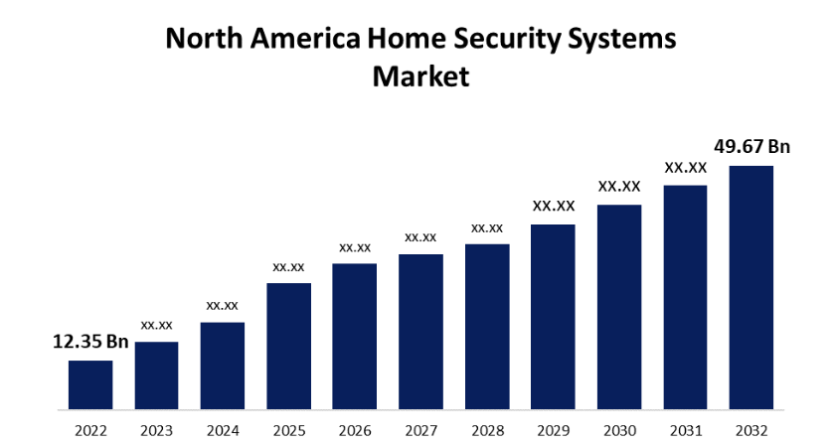
Market Overview
The North America Home Security Systems Market Size was valued at USD 12.35 Billion in 2022.
The Market is Growing at a CAGR of 14.93% from 2022 to 2032.
The North America Home Security Systems Market Size is expected to reach USD 49.67 Billion by 2032.
Notes:
Aditi

Slide 26
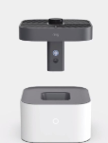
Market Segmentation Analysis
Demographic
03
04
Psychographic
Homeowners, Millennials
Security-Conscious, Tech Enthusiasts
02
05
Usage based
Geographic
Urban & Rural Areas
First-Time Home Buyers, Tech-Savvy Upgrading old Security Systems
01
06
Behavioral
Application based
Frequent Users
Occasional Users
Small Business & Property Owners, Insurance companies
Notes:
Prenidha

Slide 27
Customer Insights
Homeowners & businesses highly concerned due to break-ins.
Motion sensors, real-time alerts, AI-based threat detection.
Security
Desired Features
Data privacy, reliability, and false alarms, Safety, power outage
Security Drone Concerns
Pricing Expectations
Products currently used
$100-$500 setup; preference for one-time purchase with optional subscriptions.
Ring Doorbell, ADT, Simplisafe, Rheolink, Ring Floodlight Cam
Notes:
Aditi

Slide 28
SWOT Analysis
S
W
O
T
Privacy concerns
Regulatory & Legal Challenges
Market Leadership
Market Differentiation
Strong Ecosystem
High Manufacturing & R&D Costs
Growing market
Shrinking Younger Demographics
Innovative approach
Subscription Dependency
Partnerships with Real Estate & Homebuilders
Competition
Notes:
Pruthvi

Slide 29
Competitive Analysis
Competitor | 360° Surveillance | 4K Spy-Grade Camera | Smart Motion Detection | Facial Recognition | Live HD Video Streaming | Covers every house corner | Customizable Alerts | Child & Pet Monitoring | Tamper Detection | GPS Tracking | Privacy Controls
Ring | ✅ | ✅ | ✅ | ✅ | ✅ | ✅ | ✅ | ✅ | ✅ | ✅ | ✅
SimpliSafe | ❌ | ❌ | ✅ | ❌ | ✅ | ❌ | ✅ | ✅ | ✅ | ❌ | ✅
ADT | ❌ | NA | ✅ | ✅ | ✅ | ❌ | ✅ | ✅ | ✅ | ✅ | ✅
Deep Sentinel | ❌ | ✅ | ✅ | ✅ | ✅ | ❌ | ✅ | NA | ✅ | ✅ | ✅
Vivint | ❌ | ✅ | ✅ | ✅ | ✅ | ❌ | ✅ | ✅ | ✅ | ✅ | ✅
Frontpoint | ❌ | NA | ✅ | NA | ✅ | ❌ | ✅ | ✅ | NA | ✅ | ✅
Scout Alarm | ❌ | NA | ✅ | NA | ✅ | ❌ | ✅ | NA | ❌ | ❌ | NA
Abode | ❌ | NA | ✅ | ✅ | ✅ | ❌ | ✅ | NA | ✅ | ❌ | ✅
Notes:
Piyush

Slide 30
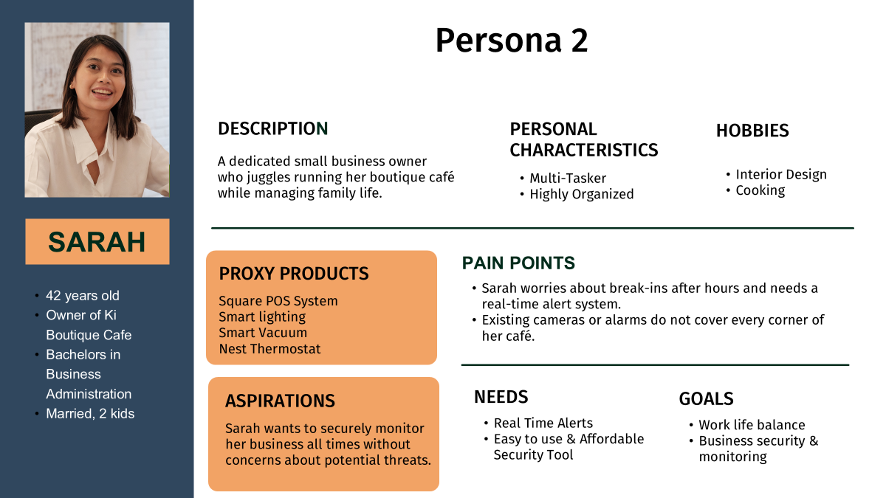
Technology Infographics
Jupiter
Mercury
Jupiter is the biggest planet of them all
It’s the closest planet of the Sun
Neptune
Earth
It’s the farthest planet from the Sun
It’s the third planet from the Sun
Saturn
Mars
It’s a gas giant and has several rings
It’s actually a cold place
Notes:
Neelima

Slide 31
Pricing Strategy
Component | Estimated Cost
Drone Hardware (Frame, Motors, Battery) | $40 - $50
Camera Module (HD/4K with Night Vision) | $30 - $40
AI & Navigation Sensors (LiDAR, IR, Gyroscopes, Accelerometers) | $50 - $60
Wi-Fi & Connectivity Modules (Cloud-based streaming, Ring integration) | $10 - $20
Docking Station (Charging + Storage) | $30 - $40
Software Development (AI Object Recognition, Pathfinding) | $20 - $30
Cloud Infrastructure & Security (AWS, Ring cloud storage) | $15 - $20
Packaging & Accessories (Power adapter, charging dock, manuals) | $5 - $10
Manufacturing & Assembly (Labor, factory costs, testing) | $20 - $30
TOTAL ESTIMATED COST | $220 - $300
Notes:
Aditi
The $249 - $299 price point for the Ring Always Home Cam aligns more with Value-Based Pricing rather than Competitive Pricing, though elements of both strategies are present.
Why is it Value-Based Pricing?
✅ Pricing Justifies Unique Value → The Ring Always Home Cam is an autonomous security drone, a first-of-its-kind consumer product. The price is set based on the value it provides (AI-powered home surveillance, automated patrolling, and real-time alerts).
✅ Solves a Pain Point → Instead of installing multiple security cameras, this single device provides whole-home coverage, making it a cost-effective alternative despite its higher price.
✅ Willingness to Pay → Customers who invest in home security products (like Ring users) value peace of mind, which justifies a premium price.
Why It’s NOT Purely Competitive Pricing
🔹 Lack of Direct Competitors → No other major brand offers an autonomous security drone. Unlike regular security cameras, it has unique features that set it apart.
🔹 Higher Perceived Value → Unlike standard security cameras priced at $100 - $200, this product justifies its higher price through advanced AI, mobility, and automation.
But There’s Some Competitive Pricing Too...
🔹 The Nest Cam IQ (a premium smart security camera) was priced at $399 before discontinuation. Ring strategically priced lower ($249 - $299) to stay more affordable than ultra-premium competitors.
🔹 Standard Ring cameras range from $100 - $200, so this device is positioned as a premium but accessible option, keeping it within Ring’s ecosystem.
Final Verdict: Primarily Value-Based Pricing
🔹 The price is not set based on competition alone but rather on the unique value the product delivers.
🔹 It’s still positioned competitively against premium security solutions, making it accessible while maintaining strong margins.

Slide 32
References
Pet Monitoring
Portland Police Bureau
Asset Protection

